Slide 1
Mobile Robot finale presentation
By
Piotr Balion
Borys Dudariev

Slide 2
Intro
During this semester we decided to create a mobile robot with a camera and some navigation possibilities, this is the progress that we have made before the presentation deadline

Slide 3
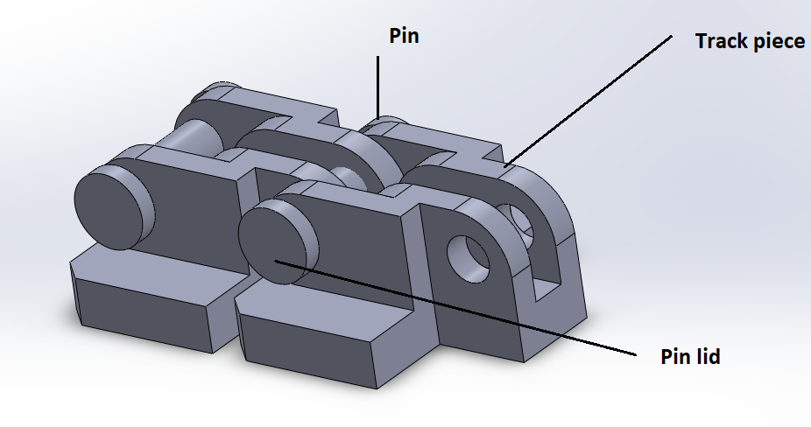
Part 1: Tracks
During our initial design, our robot was meant to use tracks, with wheels being a backup option. However, during the printing process of the tracks it was discovered, that the pin mountings were considered “structurally weak” and were filled with plastic, rendering them unusable. For this presentation, we are using the back-up option of wheel mountings

Slide 4
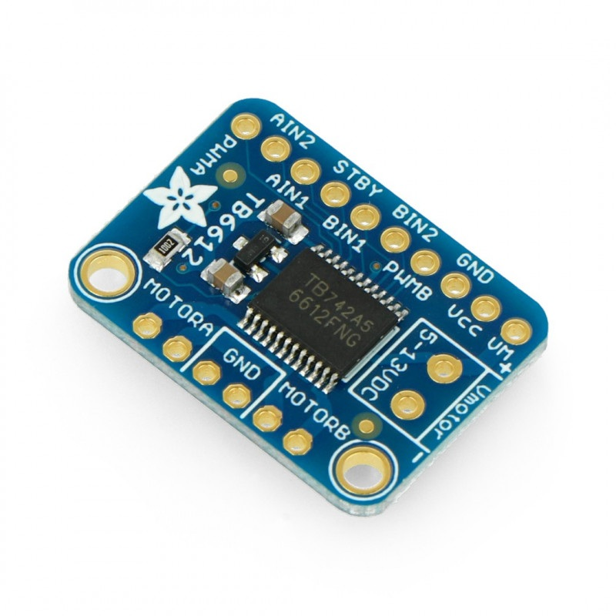
Part II: Motors
The robot was originally envisioned to be powered by either 2 or 4 DC motors, with a motor controller and power supply to make them work.
This was successfully achieved and depending on the raspberry pi that we use it can work with either 2 or 4 engines due to the bigger rpi taking up space.

Slide 5
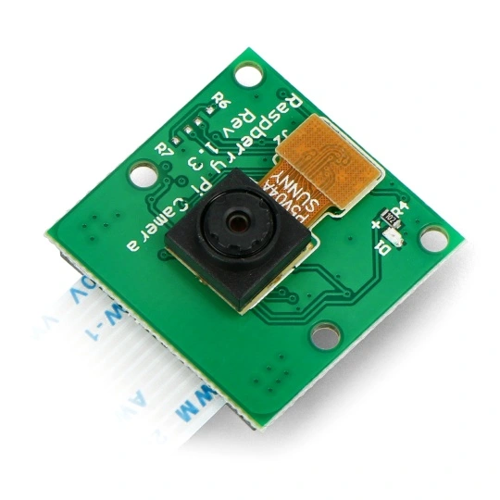
Part III: Live camera feed
In the beginning one of the ways to navigate the robot was a live camera feed proposal, this was successfully implemented. The Rpi turns on the camera, records what it sees, then sends the video to a website with the Rpi’s IP address, which has a basic webpage with the live camera feed in 720p and with 60 FPS.

Slide 6
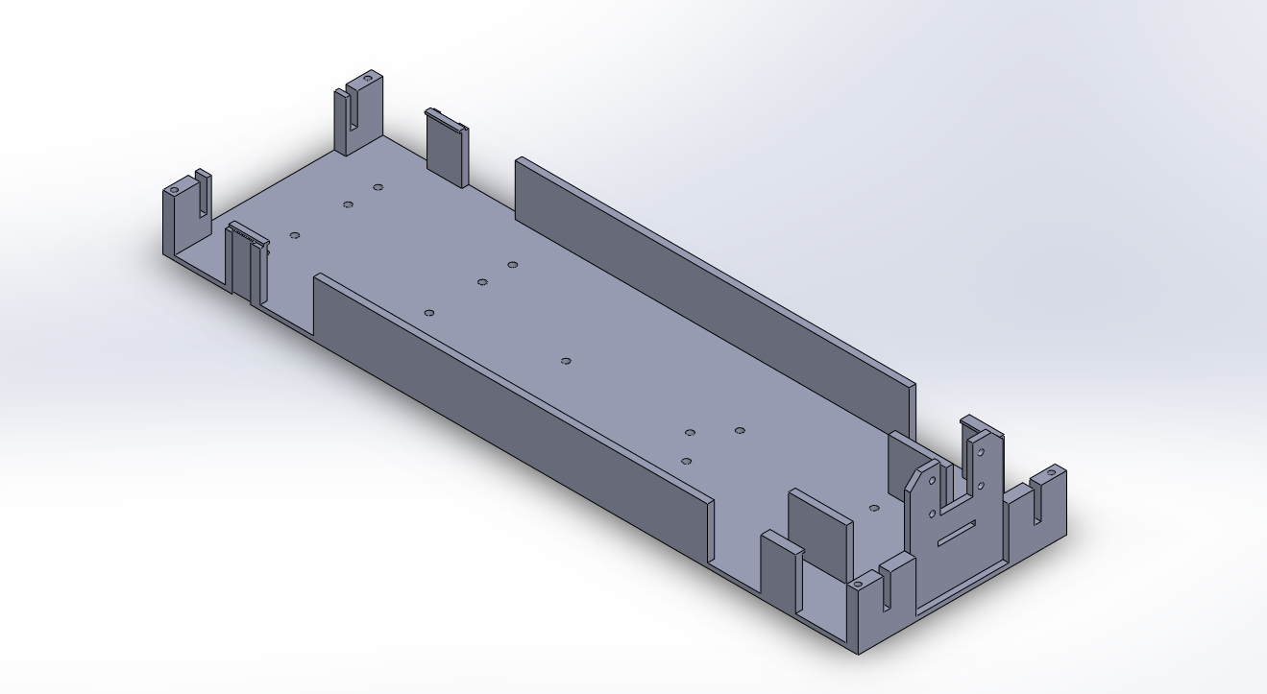
Part iv: Structure improvements
Some alterations to the hull were made in order to remove some errors that were found as well as make it more 3d printer friendly.
These include the removal of idler wheel mountings as even with tracks installed, they would be redundant, removal of chamfers and fillets, simplification of some mountings and increase in certain structural elements.

